Slide 1
Weekly Update
Late To the Party Team
Brian Zhang, Saurav Chatterjee, Zachary Stephens
Faculty Advisor: John Leonard
Sponsor: Michael Karafotis
10/21/2019

Slide 2
Goals for this Week
Explore uses and applications of Node
Keep working on Neo4j application graph and add more nodes to it
Meet with our sponsor, hopefully this week to discuss the potential route(s) we’re going to be taking with Neo4j and D3 library graphs
Create more detailed data with the Faker library

Slide 3
Accomplishments/Challenges Encountered
Accomplishments:
We were able to take some basic steps towards working with D3, Node, and Faker
Create graphs using D3 library. Work on our Neo4j graph as well.
Challenges:
D3-Chord Diagram is slow going
Faker library generates fake data, but primarily focuses on names, addresses, and other contact info. We need KPIs.
Faker also relies on Condas, a python package manager we are all unfamiliar with.
We still have a couple of alternative visualization tools to explore,
We weren’t able to touch base with our sponsor as soon as we would have liked.

Slide 4
Goals for Next Week
Explore the uses of Networkx
Explore the uses of other D3 diagrams
Determine by the end of the week which tool we are going to use moving forward
Meet with the sponsor to discuss any changes we may make

Slide 5
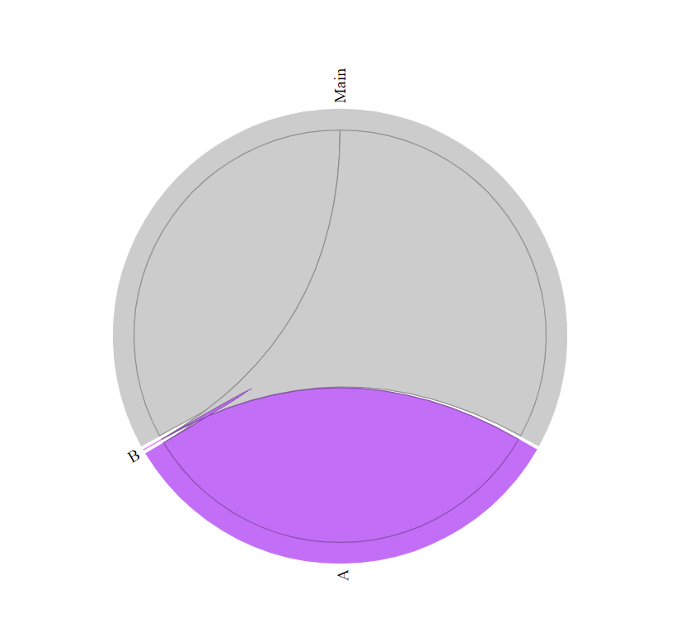
Current Progress with D3 Libraries
Chord Diagram
Shows the connections between the given nodes and data

